Slide 1
The Feathertale Review
A Literary Magazine Presentation
By Tianna Vertigan
CREW 430: Publishing Workshop I
Portal
Canada’s most decorated small illustrated literary humour magazine
Alex Gorodskoy (2013)

Slide 2
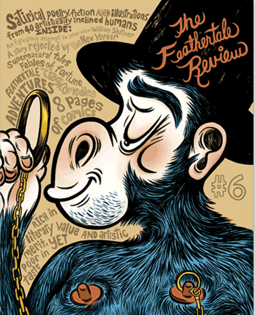
Overview
“
Goals & Accomplishments
Feathertale’s mandate is to be an innovative voice for a new generation of Canadian creators, and a forum and incubator for artistic genius. We strive to be at the fore of Canadian literary humour, showcasing the work of writers and artists for domestic and international audiences. Each issue tries to inspire its readers and contributors, challenging their view of what a magazine can be.
Big Names Published
Margaret Atwood (Art, #2)
Robert Munsch (Poetry, #1)
National Magazine Awards
Gold
2020 Art Direction (#25)
2015 Humour (#15)
2012 Best Single Issue (#9)
2010 Best Covers (#6)
Best Editorial Package, Words&Pictures, Illustration, Personal Journalism
“
+

Slide 3
Location
Physical
Based in Ontario
Founded in 2004 by Brett Popplewell
Distributed in Canada and the US
Online
Website: feathertale.com
/feathertalereview
@feathertale
@feathertalereview
500-800
followers
Feathertale
PO Box 291
Ottawa, ON K4M 1A3

Slide 4
Masthead
EDITORIAL
DEPARTMENT
ART
DEPARTMENT
SENIOR
CONTRIBUTORS
Deputy Editor
Senior Editor
Creative Director
Art Directors
Editor
Senior Writer
At Large
Junior Writer Emeritus
Benson
Lee
Brett Popplewell
Corina
Milic
Lee
H.
Wilson
Kara Pyle
Desert Correspondent
Jennifer Lawrence
Jonathan Danielson
Kevin
Scanlon
Iain
Marlow
Notes:
Also an associate professor at Carleton’s School of Journalism and Communication.

Slide 5
Masthead
PUBLISHER
D’Artagnan

Slide 6
Favourite Piece
“A Thinkpiece”
By Andrew Brobyn
Short poetry
Form suits overall style/theme
Challenges idea of litmags
Bold, risky
Helps shape poetry section
“Is that an empty bag behind you?”
“No, it’s full of empty bags…”
(2013)

Slide 7
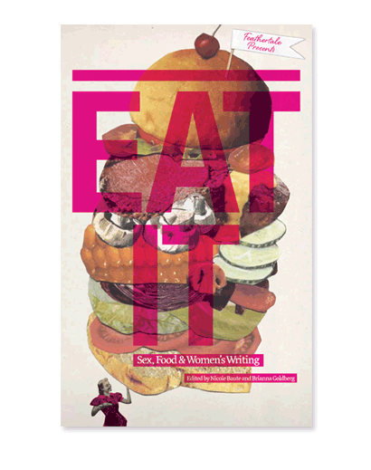
Marketing & Approach
Innovation
YA Audience
Lots of Online (free) Content
Inexpensive
Individually Tailored Covers
Humour and Sarcasm
Experimental Approaches
Issues reg. $10-15
Literary cookbook (Eat It)
LP (#14)
3D cover (#16)
Vintage magazine (#9)
Comic book (#7)
Glow-in-the-dark ink (#25)
Bi-annual publishing
! Subscription Offer !
4 New Issues + 1 Back-issue for $30
Estimated $60 value
Feathertale’s special “literary cookbook” edition
Notes:
What this says about them is that they’re willing to adapt. They haven’t always been bi-annual. Publishing more frequently might help them get their name out more.

Slide 8
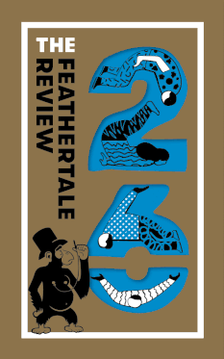
Features & Inventiveness
Online Store
Mascot/Figurehead
Monkey Banters
Youth Programs
Story Mountain Workshops
The Bully-Boy Project
Things Portal can do, too
List of Contributors
Gifs
Subscription Sign-Up
Anonymous Rants
Feathertale’s latest special edition (2021)

Slide 9
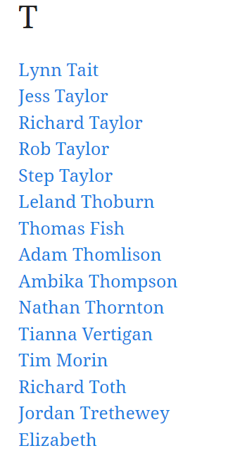
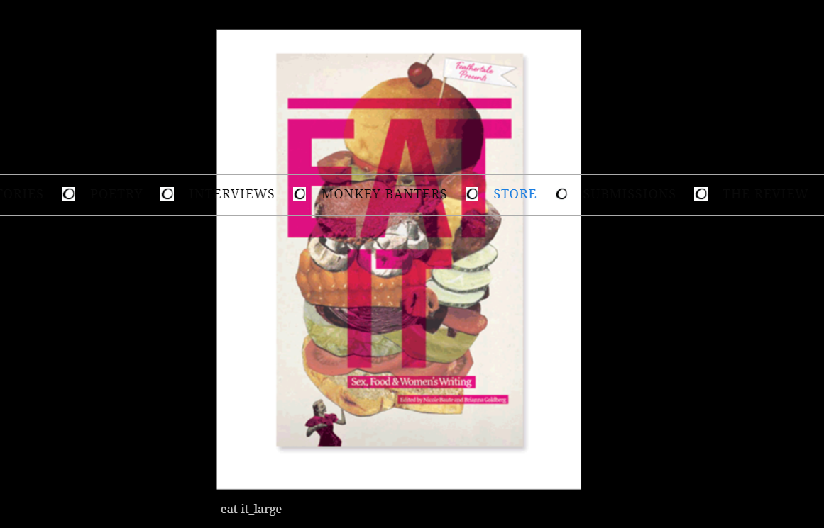
Negatives
As a reader
Inconsistent cover font
Missing information
Broken links
Formatting issues
Incorrect spelling of contributors’ names
Contributors list is… misleading
Issues with ordering process
Notes:
Although I noted Feathertale’s uniquely tailored cover styles as a positive, this comes with a cost. Changing the font style for each cover can be confusing for readers. This is especially so when it comes to the title, as readers might have trouble finding Feathertale among other litmags because their branding is less recognizable.
As for Feathertale’s website, while broken links and formatting issues aren’t the end of the world, they’re still offputting. We don’t want them there. When I was looking through Feathertale’s online store, I was entertained by the clever descriptions for each issue. However, they left out some of the more technical info. I couldn’t find a publishing year for any of the issues I clicked on. This can make things really difficult for readers who are looking for a specific issue.
some of the contributors’ names are spelled incorrectly. For example, Alex Gorodskoy is credited as Alex Gorodsky. The contributor’s list itself doesn’t make much sense, either. For one, its naming system is inconsistent. Initially, the list appears to be alphabetically sorted by first name… and sometimes last name… but sometimes it really isn’t sorted at all. Some of the names are also formatted like usernames, with underscores and periods. Why? That brings me to my second point. After ordering a few issues, I looked at the contributors list and was surprised to see my own name. I haven’t even submitted anything to Feathertale, so why am I up there? My theory is that the list includes everyone and anyone who has ever made an account on Feathertale’s website. When I was checking out, I created an account not knowing this would happen. I don’t really care that my name is there, but it does seem a little fishy to me as I definitely don’t recall consenting to it.
When I placed my order, I wasn’t expecting to receive any sort of tracking number, although an estimate would’ve been nice. I placed my order 11 days ago, and paid via paypal at the same time. I received a confirmation email from paypal letting me know that my payment went through, but I have yet to receive a shipping confirmation. Instead, when I check my order status, Feathertale says that my order is “on hold” until they can confirm payment. At this point, I’m not even sure if my order is coming, which is of course concerning as a reader.

Slide 10
Discussion
Questions
#1
How comfortable are we with experimenting with Portal
in terms of approach and features?
Are we in a position to experiment (i.e. is it necessary/affordable)?
Can you see any areas where Portal might be doing better than Feathertale?
If not, what could we work on improving?
#2
How is our consistency? Our ease of access? Creativity and style?

